Slide 1
HL7:
Enabling Interoperable Healthcare
Today and Tomorrow
Ticia L. Gerber, MHS/HP
Global Director, Partnerships and Policy
HL7

Slide 2
The HL7 Organization
Founded in 1987, Health Level Seven International (HL7), with members in over 55 countries, is a not-for-profit, ANSI-accredited standards developing organization, with affiliate HL7 standards organizations in over 30 countries
HL7 is dedicated to providing a comprehensive framework and related standards for the exchange, integration, sharing, and retrieval of electronic health information that supports clinical practice and management, delivery and evaluation of health services
HL7's 2,300+ members include approximately 500 corporate members who represent more than 90% of the information systems vendors serving healthcare
Over 45 healthcare standards from anatomic pathology to vocabulary
Take a Flash tour at http://www.hl7.org/documentcenter/public/training/IntroToHL7/player.html

Slide 3
HL7 Mission and Value
HL7's mission is to provide standards for interoperability that:
  improve care delivery
  optimize workflow
  reduce ambiguity
  enhance knowledge transfer
Wide range of healthcare standards: clinical, administrative, clinical research, electronic claims, public health, personal health, clinical genomics, etc.
Over 60 active Workgroups covering prominent federal and global topics such as mHealth, genomics, learning health systems, and health care in developing countries.

Slide 4



























An International Organization with Over 30+ HL7 Affiliates
Argentina
Czech
Republic
Japan
New
Zealand
Taiwan
Australia
Denmark
South
Korea
The
Netherlands
Turkey
Austria
Finland
United
Kingdom
Romania
Brazil
France
United
States
Russia
Canada
Germany
Uruguay
Singapore
Chile
Greece
And growing
Spain
China
Hong Kong
Columbia
Luxembourg
Sweden
India
Croatia
Italy
Mexico
Switzerland

Slide 5
HL7 Standards support a variety of healthcare activities
Orders and Results for
Clinical Lab/Pathology,
Imaging (radiology,
ultrasound, etc.)
Signs and Symptoms,
Diagnosis
and Treatments
Patient Administration
and Demographics
Clinical Research (e.g.
Genomics) and Public
Health/Disease Surveillance
Sharing and re-use of information from many healthcare domains
Pharmacy prescriptions,
dispensing and
administration
Patient Care messages,
Clinical Documents
(referrals, H&P,
Summary record, etc.)
Scheduling
and managing
healthcare
resources
Claims and
Reimbursements
Notes:
Client Issue: How can IT help in moderating the healthcare crisis?

Slide 6
Healthcare Standards Improve Patient Care
Electronic
documents
provide value
to clinicians
Ensure
clinicians
have latest
knowledge
Improve
quality of care
Benefits of Standards:
increase efficiency,
improve quality,
lower cost,
and reduce risk
Improve patient
safety/ Minimize
preventable
errors
Empower patient
to manage their
own health
Improve clinical
workflow
Improve public
health reporting
Lower cost
of healthcare
delivery
Supports
lifetime
electronic
health
record
Eliminate
duplicate
medical tests
Notes:
Client Issue: How can IT help in moderating the healthcare crisis?

Slide 7
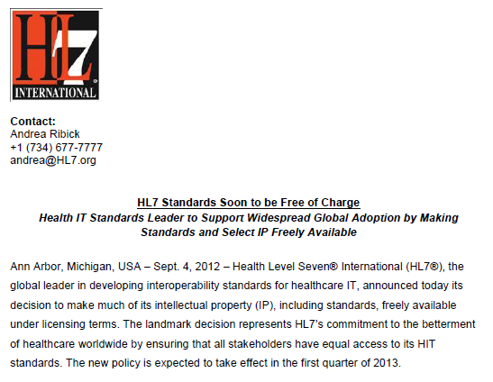
Standards and Select IP Freely Available

Slide 8
HL7 Collaboration Goals
Stimulate, encourage and facilitate healthcare domain expert participation in HL7 to develop healthcare information standards in their area of expertise
Partner with healthcare information technology users to ensure that HL7 standards meet real-world requirements, and that appropriate standards development efforts are initiated by HL7 to meet emergent federal and global requirements
Provide education to appropriate Congressional and Administration stakeholders to facilitate a coherent, realistic and fruitful transition to nationwide healthcare interoperability
Work with international actors (multi-laterals, regional institutions, NGOs and civil society) to support achievement of relevant global health and interoperability goals.

Slide 9
Additional HL7 Programs and Activities
Product and Services Guides
Working group meetings with an annual international conference
Education
Summits
Speakers and booth at conferences
E-learning courses
HL7
E-Newsletter
Ambassador Program
University
Educational Program
Best Practices
Networking among members
GovernmentStandards Project
Country Affiliates with workshops, education
IT professional Certification

Slide 10
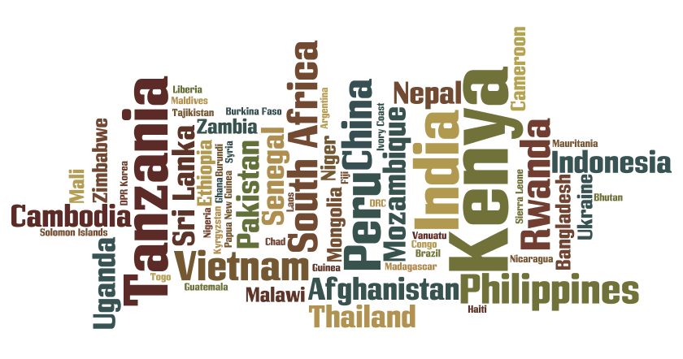
Key Countries – Global eHealth

Slide 11
Key Issues – Global eHealth
National Health Priorities and eHealth
When LMIC government decision-makers cite top national health priorities that eHealth could support they say:
Achieving progress on universal coverage
Building health system resilience
Meeting Sustainable Development Goals (SDGs)
Building people-centered and integrated health systems
Improving maternal and child health
Developing primary health care
Capacity-building/workforce training
Increasing evidence-based medicine

Slide 12


Slide 13
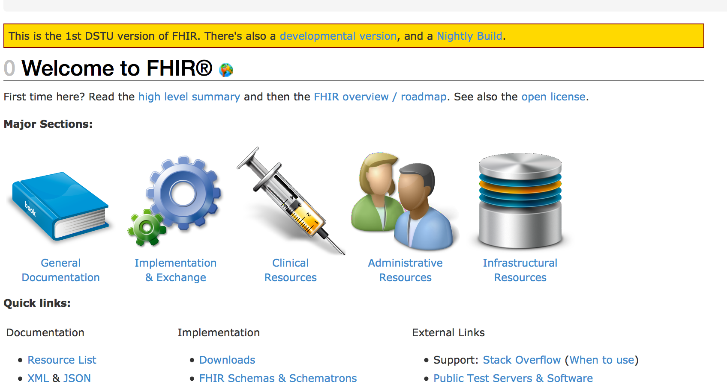

Fast Health Interoperability Resources

Slide 14
Fast Health Interoperability Resources
HL7 has been addressing these challenges by producing healthcare data exchange and information modeling standards for over 20 years. FHIR is a new specification based on emerging industry approaches, but informed by years of lessons around requirements, successes and challenges gained through defining and implementing HL7 v2, v3 and the RIM, and CDA. FHIR can be used as a stand-alone data exchange standard, but can and will also be used in partnership with existing widely used standards. (See Comparing FHIR to other HL7 standards)

Slide 15
Argonaut Initiative
Goal of Argonaut Project is to accelerate the development and adoption of HL7’s Fast Healthcare Interoperability Resources (FHIR®)
Addresses recommendations of the JASON Task Force
The development of a single implementation guide

Slide 16
Argonaut Initiative
In addition to HL7, Argonaut Project participants are:
athenahealth
Beth Israel Deaconess Medical Center
Cerner
Epic
Intermountain Healthcare
Mayo Clinic
Meditech
McKesson
Partners HealthCare System
SMART at the Boston Children’s Hospital
The Advisory Board Company

Slide 17
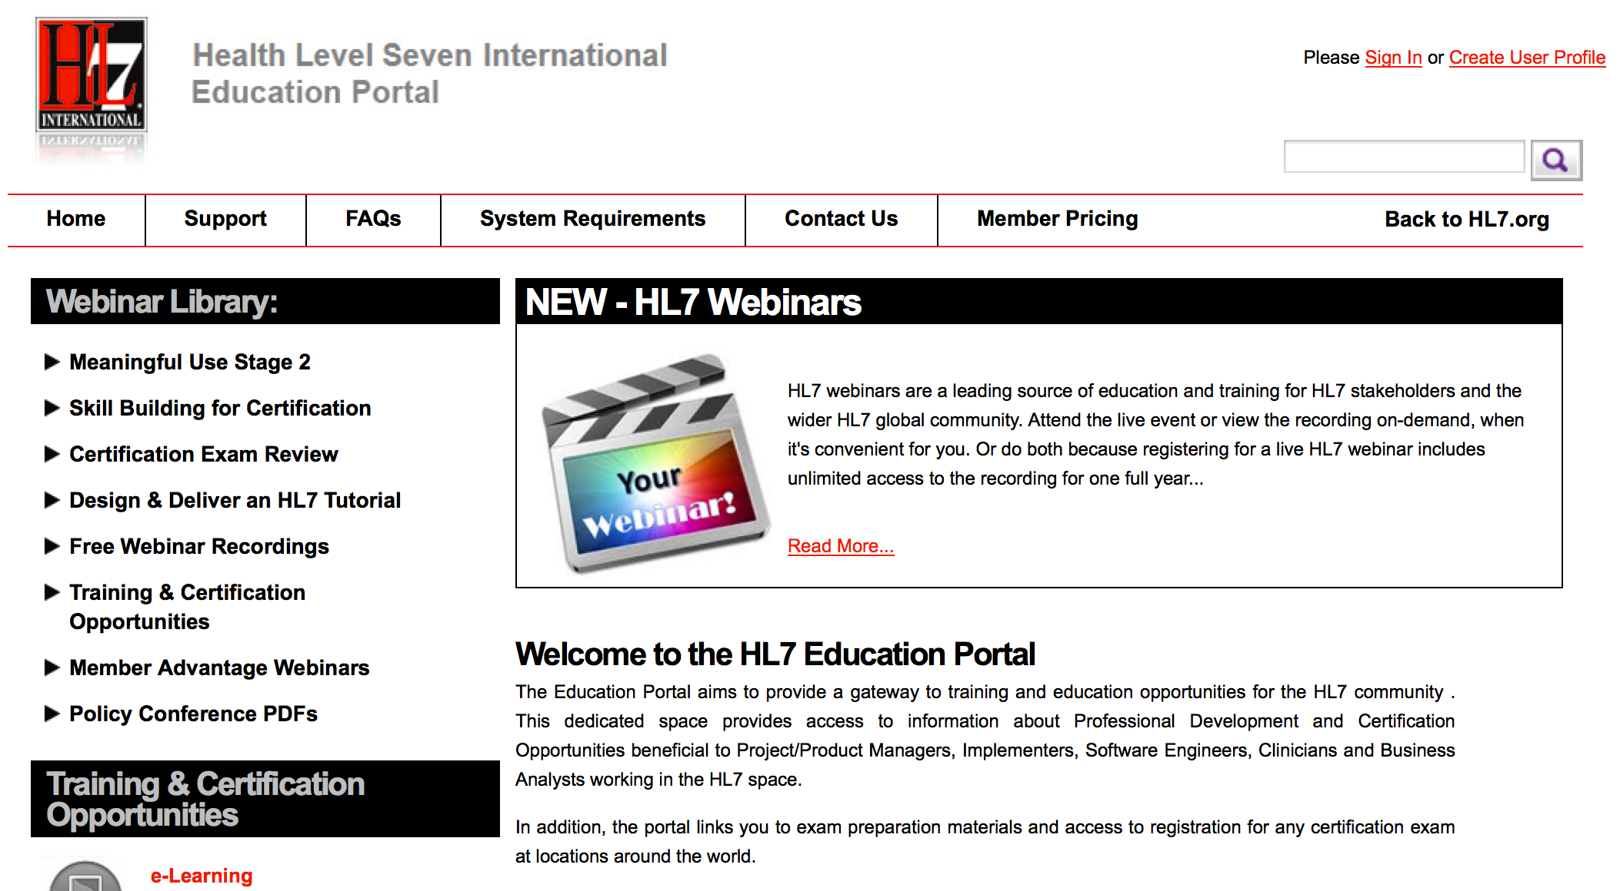
HL7 Education Portal

Slide 18
Food for Thought
(The Horizon Ahead)
“The eHealth (Health IT) space has evolved in many ways and more of this is expected. We should continue to be surprised. Most innovation will come from non-traditional places…We must have patience. It is a slow process and the priorities are not always clear. Be flexible, do not stick to rigid targets and match what needs to get done with a country’s capacity.”

Slide 19
How to get more info on HL7
Web site:
  http://www.hl7.org
International Affiliates
  http://www.hl7.org/Special/committees/international/intl.htm
Education and Tutorials
  http://www.hl7.org/education/index.cfm
Ticia Gerber, Global Director, HL7 Policy and Partnerships
  tgerber@hl7.org
Product and Services Guide
  http://productsandservices.hl7.org/Report/Report.aspx?varReport=Product

Slide 20
Thank You
Ticia Gerber
Global Director, Partnerships and Policy
HL7
tgerber@hl7.org

